Slide 1
Medicaid Expenditure update
Presentation to:
External Finance Review Council
March 11, 2020

Slide 2
Topics
DMAS Forecast vs. Actuals
Medicaid Accuracy Report
2020GA Funding Summary

Slide 3
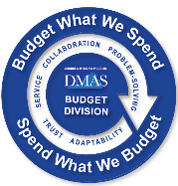
DMAS Forecast vs. Actuals – State Fiscal Year 2020

Slide 4
DMAS Forecast vs. Actuals – State Fiscal Year 2020
Notes:
Open enrollment in November through December
Base Medicaid has enrollment all year round
We will expect seasonal population bumps in the future
The population has since leveled off- this is a level shift, not a change in trend
Increased population leads to increases in capitation payments made in February and beyond
Decrease in expenditures in December due to a reclassification of pharmacy rebates from Base to MedEx

Slide 5
DMAS Forecast vs. Actuals – State Fiscal Year 2020

Slide 6
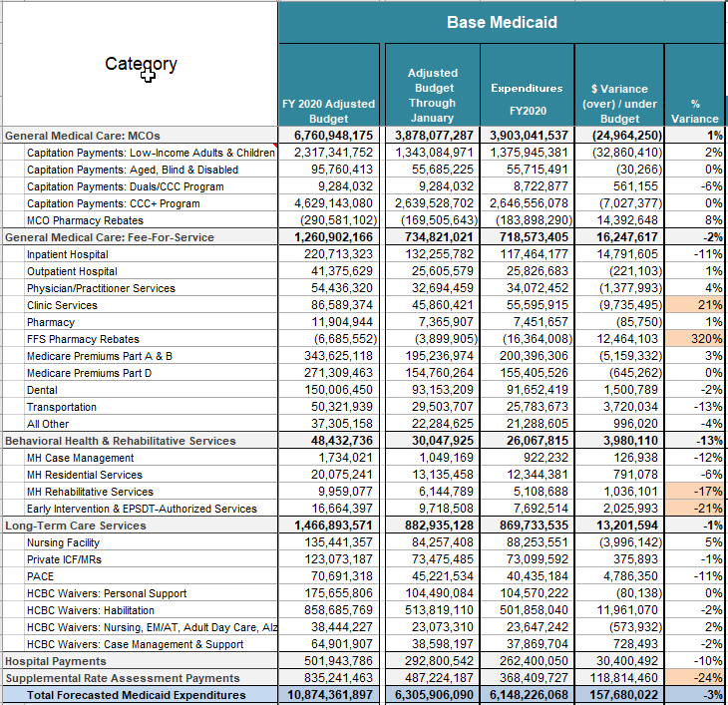
Medicaid Accuracy Report – January 2020
Notes:
Clinic Services –
FFS Rx Rebates –
Behavioral Health – Restated expenditures to align with the forecast category. Also, there are 2 Forecast Series: LTC Facility (MH case mgmt. and residential services) and LTC Community (MH rehab, early intervention and EPSDT-authorized series) when summarized by forecast series and realigned by forecast category the variance is approximately 2% for LTC Community
Supplemental Rate Assessment Payments -

Slide 7
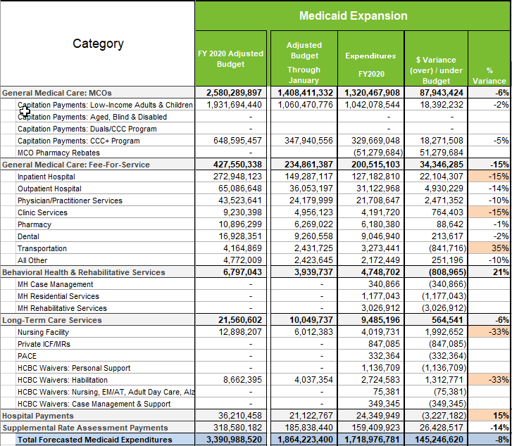
Medicaid Accuracy Report – January 2020
Notes:
Inpatient Hospital –
Clinic Services –
Transportation –
LTC Services:
Nursing Facility – When you combine NF, ICF/MR and PACE the variance is -14%. Expenditure growth has been below forecast
HCBC Waiver Services - When you combine all HCBC waiver services the variance is 6%. Expenditure growth is above forecast.

Slide 8
Medicaid Accuracy Report – January 2020 Total
Notes:
Balance in VHCF on Jan 30, 2020 - $8.9 million

Slide 9
2020GA Funding Summary
 | FY 2020 | FY 2021 | FY 2022
Base Appropriation | $4,989 | $4,989 | $4,989
Introduced Budget: U&I Forecast | ($211.70) | $174.50 | $500.50
Introduced Budget: Spending Initiatives | $0.00 | $34.60 | $64.90
Introduced Budget: Reduction/Savings | ($44.40) | ($110.40) | ($131.70)
Total Introduced Budget | $4,733 | $5,088 | $5,423
$ in millions, General Funds
 | FY 2020 | FY 2021 | FY 2022
Conference: Spending Initiatives | $0.00 | $89.9 | $127.80
Conference: Reduction/Savings | ($5.9) | ($40.1) | ($72.70)
Total Conference Budget | $4,727 | $5,138 | $5,478
$ in millions, General Funds
Notes:
GIB Spending Initiatives:
Increase waiver slots
Rate increases: waiver rates, MH provider rates
New program
GIB Reduction/Savings:
Conference: Reduction/Savings
Rates increases: waiver rates, NF rates, personal, respite & companion care, skilled/private duty nursing, psych facililty
New Programs: adult dental
Conference: Spending Initiatives

