Slide 1
Metabolic Monitoring for Children and Adolescents on Antipsychotics (APM) Measure Rates
Ray Berens, Senior Analyst
Health Services Advisory Group, Inc. (HSAG)
January 24, 2017

Slide 2
Activity Overview
Virginia Department of Medical Assistance Services (DMAS) contracted with Health Services Advisory Group, Inc. (HSAG) to calculate the following performance measure:
Metabolic Monitoring for Children and Adolescents on Antipsychotics (APM) (NQF #2800)
Measurement period: January 1 – December 31, 2015
Claims with a first date of service from January 1, 2015 to December 31, 2015 were included.

Slide 3
Review of Performance Measure
APM assesses the percentage of children and adolescents 1–17 years of age who had two or more antipsychotic prescriptions and had metabolic testing with both of the following tests:
At least one test for blood glucose or hemoglobin HbA1c
At least one test of low-density lipoprotein cholesterol (LDL-C) or cholesterol

Slide 4
Measure Calculation
Administrative data sources provided by DMAS were used for the rate calculation.
Rates were calculated as a percent.
Age was determined as of December 31, 2015.
Results were calculated for the overall Medicaid managed care population.

Slide 5
Reviewing and Interpreting Results
Measure results with numerators fewer than 11 were not presented.
Since HEDIS specifications were followed, statewide results and age group results can be compared to national benchmarks.

Slide 6
APM Performance Measure Results
6

Slide 7
Performance Measure Results
Virginia total APM measure results:
28.08%
This is between the national Medicaid 50th and 75th percentile¹
Above results were stratified by the following:
Managed care geographic regions (using Federal Information Processing Standards [FIPS] codes)
Age group
Gender
Race category
¹Benchmarking data is derived from 2015 HEDIS Audit Means and Percentiles

Slide 8
Results by Managed Care Geographic Region
8

Slide 9
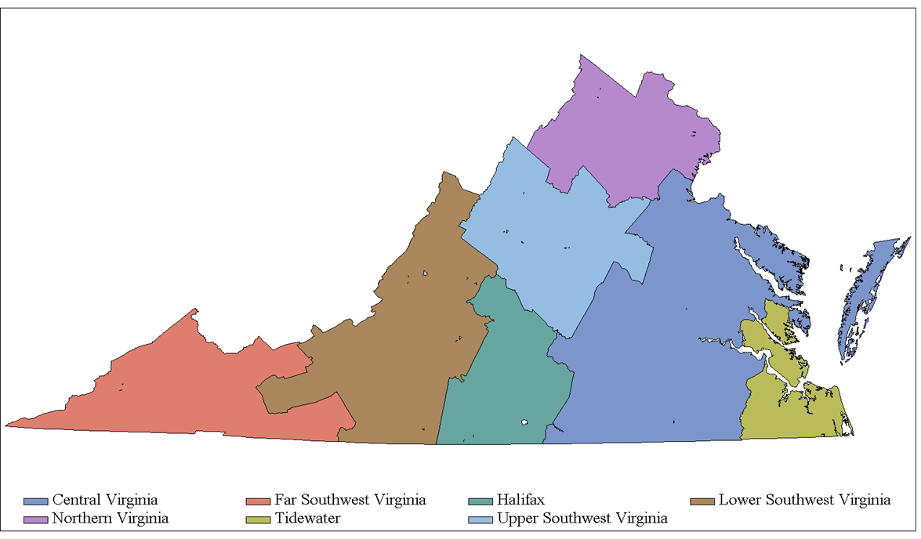
Results by Managed Care Geographic Region
APM Measure Results by Managed Care Geographic Region
25.94%
28.57%
33.80%
20.87%
33.74%
25.99%
29.34%

Slide 10
Results by Age Group
10

Slide 11
Results by Age Group

Slide 12
Results by Gender
12

Slide 13
Results by Gender

Slide 14
Results by Race Category
14

Slide 15
Results by Race Category
*Due to small numerators (i.e., less than 11), the following race categories were not reported: Asian, Southeast Asian/Pacific Islander.

Slide 16
Questions?
16

Slide 17
Thank you!
Ray Berens
rberens@hsag.com
17

