Slide 1
Prevention Quality Indicators (PQI) #3: Diabetes Long-Term Complications Admission Rate
October 27, 2015

Slide 2
Activity Overview
Virginia Department of Medical Assistance Services (DMAS) contracted with Health Services Advisory Group, Inc. (HSAG) to calculate the following performance measure:
  Prevention Quality Indicators (PQI) #3: Diabetes Long-Term Complications Admission Rate (NQF #274)
Measurement period: January 1 – December 31, 2014
  Claims with a first date of service from January 1, 2014 to December 31, 2014 were included.
Notes:
DMAS selected PQI #3 for CY 2014. Please note, historical data for Virginia are not available for this measure since this was the first year this measure was calculated as part of the EQRO contract.

Slide 3
Review of Performance Measure
PQI #3 assesses the number of admissions for members ages 18 years and older with a principal diagnosis of diabetes with the following long-term complications:¹
  Renal
  Eye
  Neurological
  Circulatory
  Complications not otherwise specified
Excludes obstetric admissions and transfers from other institutions.
¹ Agency for Healthcare Quality and Research, Quality Indicators™ Research Version 5.0, Prevention Quality Indicator #3, Technical Specifications, Diabetes Long-Term Complications Admission Rate, March 2015, Retrieved on June 4, 2015. http://www.qualityindicators.ahrq.gov/Downloads/Modules/PQI/V50/TechSpecs/PQI_03_Diabetes_Long-term_Complications_Admission_Rate.pdf
Notes:
HSAG followed the technical specifications created by AHRQ. However, DMAS limited the population to Medicaid managed care members as opposed to a general adult population in a metropolitan area or county.

Slide 4
Measure Calculation
Administrative data sources provided by DMAS were used for the rate calculation.
Rates were calculated per 1,000 members.
Each member’s contribution to the denominator was weighted by the number of months the member was enrolled and met the age requirements during the measurement year.
  For example, a member enrolled from January – June 2014 only counted as half a member.
Age and enrollment was determined on the 15th day of each month.
  Age was calculated every month to ensure each member was weighted by the number of months they were enrolled and eligible.
Notes:
Administrative data sources included demographic, enrollment, encounter, and institutional data. In order to achieve the most appropriate and cost-effective analysis of performance measure data, HSAG provided DMAS with a data file extract request in May 2015 including the administrative data time periods, submission deadlines, and submission guidelines. HSAG requested member enrollment and demographic files, and claims and encounter data files for Medicaid managed care eligible individuals. DMAS supplied SAS data sets extracted by claims’ paid dates. The date range for the claims and encounter data (i.e., paid dates) was from January 1, 2013 – June 30, 2015. HSAG received data from DMAS in July 2015.

Slide 5
Measure Calculation (Cont’d)
Results were calculated for the overall Medicaid managed care population and for a subset of Medicaid managed care members with diabetes.²
Due to limited availability of data for members over age 65 (i.e., Medicare claims), results presented only include members under age 65.
² The diabetic Medicaid managed care population was defined according to the Comprehensive Diabetes Care measure from the 2015 Health Care Effectiveness Data and Information Set (HEDIS®) Technical Specifications, Volume 2. HEDIS® is a registered trademark of the National Committee for Quality Assurance (NCQA).
Notes:
HSAG and DMAS elected to calculate the measure for two populations (the Medicaid managed care population and the diabetic Medicaid managed care population) in order to provide more meaningful results regarding diabetic complications. AHRQ’s measure specifications for the denominator included any adult over the age of 18. However, HSAG had limited data for members over age 65 (i.e., HSAG did not receive Medicare data). As a result, when HSAG calculated the results for all adult members, the data for members age 65+ were artificially driving the overall age 18+ rate downward. In order to accurately present the results, HSAG and DMAS decided to limit the rate calculations to members ages 18 to 65.

Slide 6
Reviewing and Interpreting Results
Measure results with numerators fewer than 11 were not presented.
Caution should be used when comparing these results to publicly available benchmarks.
  Benchmarks released by the Agency for Healthcare Research and Quality (AHRQ) use Healthcare Cost and Utilization Project (HCUP) State Inpatient Databases (SID) data to produce benchmarks for PQI #3 for the overall population and the diabetic population.
    HCUP SID data contain all-payer (i.e., not limited to a Medicaid population), encounter-level information.
    HCUP SID data denominators are derived from members in the metropolitan area or county.
    HSAG’s results were calculated using only Medicaid data.
Notes:
The numerator was less than 11 for one geographic region (i.e., Halifax), one age stratification (i.e., 18-24), and several race categories (i.e., Asian, Southeast Asian/Pacific Islander, Hispanic, or More than one race/Other/Unknown). Given that the population used for the PQI 3 rate calculation was different than the intended use of the specifications, caution must be used when comparing results to benchmarks.

Slide 7
PQI #3 Performance Measure Results

Slide 8
Performance Measure Results
Virginia total PQI #3 measure results
  Medicaid Managed Care:
    0.98 admissions per 1,000 members
  Medicaid Managed Care—Diabetic Population:
    9.07 admissions per 1,000 members with diabetes
Above results were stratified by the following:
  Managed care geographic regions (using Federal Information Processing Standards [FIPS] codes)
  Age group
  Gender
  Race category
Notes:
The diabetic Medicaid managed care population had a higher rate of admissions due to diabetic complications (9.07 admissions per 1,000 Medicaid managed care diabetic members) in comparison to the general Medicaid managed care population (.98 admissions per 1,000 Medicaid managed care members) in Virginia.

Slide 9
Results by Managed Care Geographic Region

Slide 10
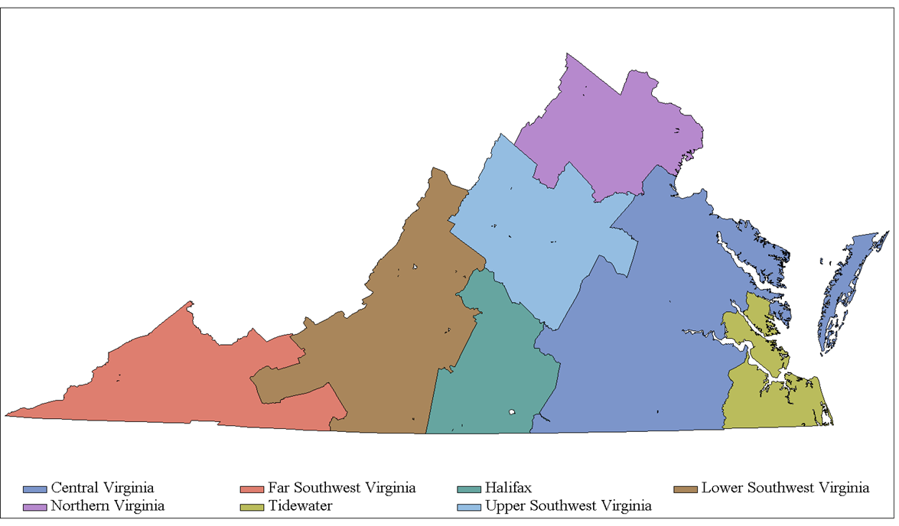
Results by Managed Care Geographic Region
PQI #3 Measure Results by Managed Care Geographic Region
(Rates per 1,000 Medicaid Managed Care Members)
0.93
1.27
0.80
1.36
0.75
—
0.92
— Indicates too few members were in the numerator to be reported for this region.
Notes:
Central Virginia had the highest rate of admissions due to diabetic complications with 1.36 admissions per 1,000 Medicaid managed care members, whereas Far Southwest Virginia had the lowest rate of admissions due to diabetic complications with .75 admissions per 1,000 Medicaid managed care members. Overall the rate of admissions due to diabetic complications for the Medicaid managed care members in Virginia was 0.98 admissions per 1,000 members.

Slide 11

Results by Managed Care Geographic Region (Cont’d)
PQI #3 Measure Results by Managed Care Geographic Region
(Rates per 1,000 Medicaid Managed Care Diabetic Members)
8.11
12.00
8.76
12.64
5.46
—
9.26
— Indicates too few members were in the numerator to be reported for this region.
Notes:
For the Medicaid managed care diabetic members, Central Virginia had the highest rate of admissions due to diabetic complications (12.64 admissions per 1,000 Medicaid managed care diabetic members), whereas Far Southwest Virginia had the lowest rate of admissions due to diabetic complications (5.46 per 1,000 Medicaid managed care diabetic members). Overall the rate of admissions due to diabetic complications for the diabetic Medicaid managed care members in Virginia was 9.07 admissions per 1,000 members.

Slide 12
Results by Age Group

Slide 13
Results by Age Group
Notes:
As age increases, the incidence of admissions due to diabetic complications increases for the Medicaid managed care population. Please note, the number of 18 to 24 year olds with an admission due to diabetic complications was less than 11; therefore, the results are not presented. However, the rate for the 18 to 24 year olds is still included in the Virginia total rate.

Slide 14
Results by Age Group (Cont’d)
Notes:
For the diabetic Medicaid managed care population, the 55 to 64 year olds had a lower rate of admissions due to diabetic complications than the 35 to 44 year olds, and the 45 to 54 year olds. Please note, the number of 18 to 24 year olds with a diabetic complication was less than 11; therefore, the results are not presented. However, the rate for the 18 to 24 year olds is still included in the Virginia total rate.

Slide 15
Results by Gender

Slide 16
Results by Gender
Notes:
Male Medicaid managed care members had higher rates of admissions due to diabetic complications than females.

Slide 17
Results by Gender (Cont’d)
Notes:
Male diabetics had higher rates of admissions due to diabetic complications than female diabetics.

Slide 18
Results by Race Category

Slide 19
Results by Race Category
*Due to small numerators (i.e., less than 11), the following race categories were not reported: Asian, Southeast Asian/Pacific Islander, Hispanic, or More than one race/Other/Unknown.
Notes:
Black/African American Medicaid managed care members had a higher rate (1.17 admissions per 1,000 Medicaid managed care members) of admissions due to diabetic complications than White managed care members (.92 admissions per 1,000 Medicaid managed care members). Although several race categories were not reported due to low numerators, the other race categories are included in the Virginia Total rate.

Slide 20
Results by Race Category (Cont’d)
*Due to small numerators (i.e., less than 11), the following race categories were not reported: Asian, Southeast Asian/Pacific Islander, Hispanic, or More than one race/Other/Unknown.
Notes:
Black/African American Medicaid managed care members had a higher rate (10.36 admissions per 1,000 Medicaid managed care diabetic members) of admissions due to diabetic complications than White managed care members (8.45 admissions per 1,000 Medicaid managed care diabetic members). Although several race categories were not reported due to low numerators, the other race categories are included in the Virginia Total rate.

Slide 21
Questions?

Slide 22
Thank you!

