Slide 1

Virginia - SBS Concierge Meeting
School-Based Services

Slide 2
AGENDA OVERVIEW
Agenda Items
1
Delegate access assigned by PAH
Can delegate access be limited, such as remittance only access?
2
New PAH access when prior PAH leaves
What process assigns a new PAH if access was not reassigned?
3
DOE license renewal and ORP revalidation timing
How far in advance must renewals and revalidations be submitted?
4
School social worker license-type correction
How should divisions correct prior LCSW mapping issues that trigger ORP denial?
5
Updated ORP enrollment instructions
Can school divisions receive a new screenshot-based job aid for recent updates?
DMAS / Gainwell ORP Enrollment Discussion
03

Slide 3

AGENDA ITEM 1
1
ACCESS
Delegate access assigned by PAH
QUESTION
Can a PAH assign limited delegate access, such as remittance only access?
Answer
How to configure
• PAH or Delegate Administrator logs into MES → Provider Management → PRSS Portal.
• Open Maintenance → Manage Delegates; add or open the delegate and set the delegate to Active.
• Choose either “Assign All Service Locations / Assign Selected Security Functions” or “Select Service Locations / Security Functions.”
• Submit, then have the delegate log in and verify they can retrieve RA notices from Resources → File Download.
• The Provider Portal supports limited delegate access through selected service locations and selected security functions.
• Remittance Advices/RAs are accessed through the “Resources File Download” security function. Resources → File Download, which includes Remittance Advice (RA) notices.
• If a delegate should not be able to download RAs, do not assign them the Resources File Download role/function.
DMAS / Gainwell ORP Enrollment Discussion
04

Slide 4
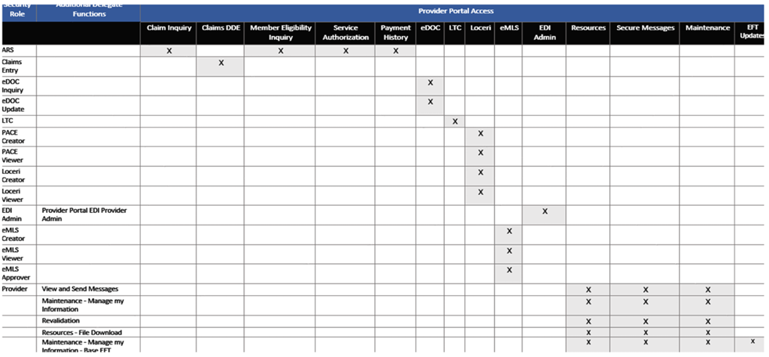
AGENDA ITEM 1
Delegate access assigned by PAH
The chart describes the Security Roles, Additional Functionality Roles, and Provider Portal Access by Security Rol.
04

Slide 5

AGENDA ITEM 3
3
PAH TRANSFER
New PAH access when prior PAH leaves
QUESTION
What is the process to assign a new PAH when the previous PAH leaves without reassigning access?
Answer
• Submit a Primary Account Holder (PAH) update form to Gainwell.
• Forms must be completed electronically, not handwritten.
• Email completed forms to VAMedicaidProviderEnrollment@gainwelltechnologies.com or send by fax.
• The form must be signed by an Owner, Managing Employee, or Authorized Individual on file with Virginia Medicaid.
PAH Request Form Guide
Primary Account Holder Request Form
DMAS / Gainwell ORP Enrollment Discussion
06

Slide 6

AGENDA ITEM 2
2
TIMING
DOE license renewal and ORP revalidation
QUESTION
How far in advance should DOE licenses be renewed, and when should ORP revalidation be submitted to avoid termination?
Answer
DOE / ORP details
• Revalidation is available 90 days before the due date; Recommendation is to submit as soon as possible once notification is received.
• If revalidation is not completed/submitted timely, the Service Location can terminate;
• Renew the Department of Education license early enough to receive the updated credential before expiration.
• After renewal, update the license information in PRSS so the provider record matches the renewed DOE license.
• Submit the updated license to PRSS at least 5 days before expiration to allow processing and avoid termination risk.
• PS 175 School Social Worker is OPR-only and requires DOE license/certification.
• The DOE license should show the School Social Worker endorsement.
DMAS / Gainwell ORP Enrollment Discussion
05

Slide 7

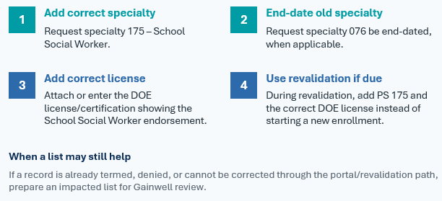
AGENDA ITEM 4
4
CORRECTION
School social worker ORP correction process
How should school divisions correct prior license type mapping issues that cause ORP denial?
Answer
• The correct school social worker path: PS 175 School Social Worker, OPR-only, DOE license/certification required.
• Add specialty 175 through a Provider Portal specialty update or during revalidation; attach the School Social Worker license.
• End-date specialty PS 076.
DMAS / Gainwell ORP Enrollment Discussion
07

Slide 8

AGENDA ITEM 5
5
JOB AID
Updated ORP enrollment instructions
QUESTION
Can school divisions receive updated ORP enrollment instructions with screenshots for the new updates?
Answer
A new updated ORP guide will be published on the DMAS website. You can find the updated document by going to the School-Based Services page, under Interim Claiming, and select Ordering, Referring, Prescribing Enrollment Instructions with screenshots.
School Based Services
DMAS / Gainwell ORP Enrollment Discussion
08

Slide 9
Helpful Guides
Provider Portal Guide R30.21
Provider Enrollment Guide R30.21
APR 2026
MAY 2026
Delegate roles, selected security functions, switch provider, PAH / delegate screens, revalidation, payment history, and resources.
Current enrollment UI, provider extract check, OPR overview, revalidation FAQs, ATN / registration steps, and self-service maintenance.
Download Provider Extract
MES Access Guides
APR 2026
Lists all active, enrolled Virginia Medicaid providers, revalidation dates and zip codes for related service locations. Providers can download the file and use the spreadsheet to see if all their NPIs and service locations are enrolled
• Go to the Virginia Medicaid MCO Provider Network Resources page:
https://vamedicaid.dmas.virginia.gov/provider/mco
• Scroll to the MCO Network Provider Enrollment section of the page.
• Under Check your enrollment status, select the link for the All Enrolled Provider Extract.
MES login, module access based on role permissions, additional access routing, and ICAM approval process.
DMAS / Gainwell ORP Enrollment Discussion
04

Slide 10


Questions?

Slide 11
Thank you!

