Slide 1

Adult Dental Services for Virginia Medicaid Members
Coming July 2021
Bryan Talbert, MPH
Contract Administrator
Zachary P. Hairston, DDS
Dental Consultant
Lisa BiLik
Dental Contract Administrator

Slide 2
Today’s Agenda
Welcome and Introductions
New Adult Dental
Smiles For Children
Coverage Changes
Related Services
Q & A Session

Slide 3





New Adult Dental Benefit
Effective Date
Implementation Steps:
July 1, 2021
Population
  Federal Approval
  Design Benefit Package
  Provider Recruitment
  System Changes
  Vendor Contract Changes
  Member & Provider Education
  Stakeholder Engagement
  Hiring a Dental Program Lead
Approximately 750,000 members who receive full Medicaid benefits
Benefit Model
Comprehensive benefits based on a preventive, restorative model
Strategic Partnership
Work with key partners to assist with design, delivery of new services and recruitment

Slide 4


What is Smiles For Children?
Established in 2005, Smiles For Children (SFC) is the Virginia dental program designed to improve access to high quality dental services for children, and now adults, enrolled in Medicaid.
The program will celebrate its 16th anniversary in 2021, and offers benefits to over 1.5 million Virginians.
SFC offers varying levels of benefits for its members.
Administered by DentaQuest.
4
Notes:
The SFC program started in 2005. It was started similarly to how adults are being added to the program, through legislative action and engagement of the Dental Advisory Committee (DAC) and key stakeholders.
The overall goals for the program address increasing the provider network, increasing utilization of dental services, and engaging stakeholders and organizations across the Commonwealth to provide much needed dental services to all Virginians.
To accomplish these goals, the program provides comprehensive dental services for members up through age 20 years. The services include braces, crowns, fillings, cleanings, oral surgeries.
In 2015, services were added for pregnant women. Services are provided through the end of the month of the 60th day post partum. The services for pregnant women are the same as for children, with the exception of braces.
Currently, services for adults, 21 years of age and older, are very limited, e.g extractions.
The MCOs added some enhanced services for adults through CCC+ and M4, but they are not comprehensive – fillings, cleanings.
NOW, DMAS has the exciting opportunity to help over 750,000 adults receive dental care.

Slide 5
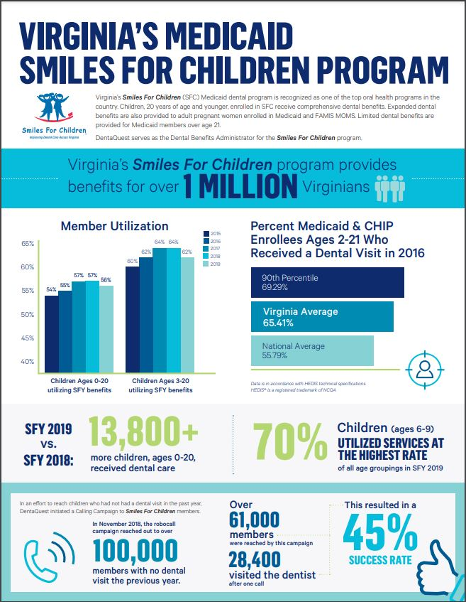
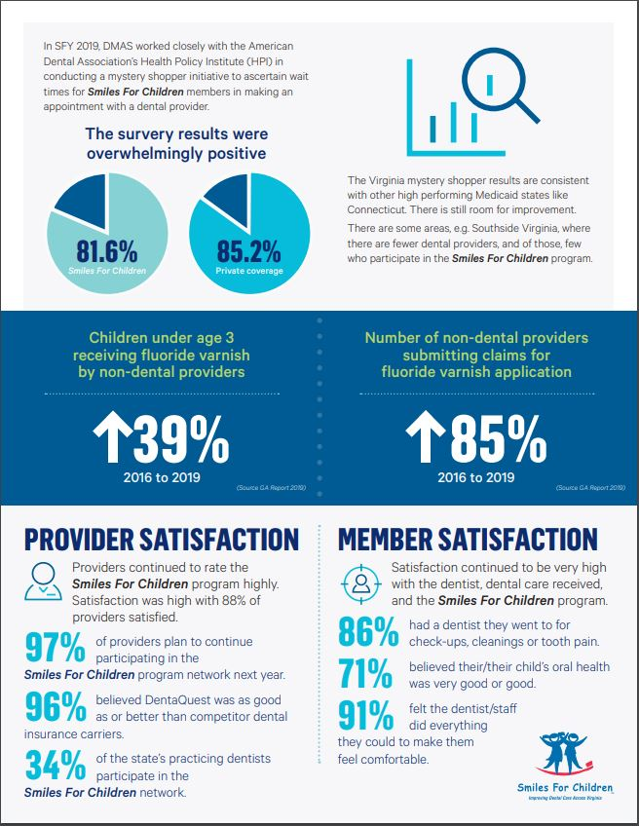
SFC Data
Notes:
This is an infographic for the SFC program.
Nationally, Virginia is ranked 14th nationally for percentage of children receiving any dental service
Virginia is ranked 11th nationally for percentage of children receiving preventive dental services
As of November 1, 2019 1,945 dentists are participating in the SFC program:
This represents approximately 26% of the 7,593 Virginia licensed dentists.
34% of the states practicing dentists participate in the SFC program.

Slide 6


What is Covered? - Children Under Age 21
Regular dental checkups
X-rays
Cleaning and fluoride
Sealants
Information and education
Space maintainers
Braces
Anesthesia
Extractions
Root canal treatment
Crowns
6

Slide 7

What is Covered? – For Pregnant Members
X-rays
Exams
Cleanings
Fillings
Root canals
Gum related treatment
Crowns, partials, and dentures
Extractions
other oral surgeries
7

Slide 8


What is Covered? – For Pregnant Members
Braces are NOT covered
Dental benefits discontinue at the end of the month following the 60th day postpartum
  EXAMPLE: If the baby is delivered January 15, 2021 the mother’s dental benefits end March 30, 2021.
If individual is still Medicaid eligible after this time they may move in the Adult-Over 21, limited dental benefit
8

Slide 9

What is Covered? – For Adults Age 21 and Older
Through June 30, 2021
Smiles For Children members 21 years of age or older that are not pregnant receive limited dental benefits including medically necessary extractions and associated diagnostic services (ex: x-rays, problem focused exams) when performed by a participating dentist.

Slide 10
A Health Body Starts With A Healthy Mouth

Slide 11

What is Covered? – For Adults Age 21 and Older
Beginning July 1, 2021
X-rays and examinations
Cleanings
Fillings
Root canals
Gum related treatment
Dentures
Tooth extractions and other oral surgeries
Other appropriate general services such as anesthesia
11

Slide 12

Other Related Services
Transportation may be available to dental appointments if the member has no other means of transportation. Members should contact the MCO listed on the insurance card.
Translation services are available during their appointment. Members can call 1-888-912-3456 for more information or ask the dentist for assistance.
12

Slide 13
Visit The Department Of Medical Assistance Services To Get More Information On The New Adult Dental Benefit And The SFC Program
Frequently Asked Questions (FAQs)
https://www.dmas.virginia.gov/media/3278/adult-dental-benefit-faqs-dmas-approved-2-23-21.pdf
Member Information
https://www.dmas.virginia.gov/media/3202/member-fact-sheet-on-new-adult-dental-benefit.pdf

Slide 14


How Members Can Find A Dentist And Ask Questions About The New Adult Dental Benefits And The SFC Program
For individuals with Smiles for Children
www.dentaquest.com
Call 1-888-912-3456
14

Slide 15

Overview Adult Benefits Go Live – July 1, 2021
All enhanced adult benefits previously offered will end June 30, 2021 and there will be a smooth transition into the new comprehensive benefit under Smiles For Children
Adults over age 21 who are receiving full Medicaid and FAMIS benefits are eligible to receive appropriate comprehensive dental benefits (excluding orthodontia) through Virginia’s dental program, Smiles For Children
DentaQuest uses the 12 digit Medicaid ID number as the enrollee ID number for the adult benefit
15

Slide 16


