Slide 1
RMTS Training & Certification: A Quick Guide
Emily Hall
Jill Robinson
Carmen Johnson
Notes:
Introductions

Slide 2
Agenda
01. RMTS Training
02. Review Statewide Data
03. Coordinator Role
04. Options to Complete
05. Training Summary Reports
06. Optional Templates
Notes:
Quick review--”take-away” reminders, resources, and samples

Slide 3
Why RMTS Training Matters
RMTS participation supports reimbursement
Training completion is required annually and should be completed before moments are completed
Improve the quality, consistency, and confidence of staff responses
Notes:
Emily expand on noncompliant risks/concerns*

Slide 4
VA RMTS Participant Training Overview
Username and temporary password are emailed to the provider
Training covers:
Introduction to RMTS
Explanation of participant role
Step-by-step walkthrough of responding to moments
Helpful tips for successful completion
Recorded training video (approximately 25 minutes)
No quiz or test required at the end of the training
Notes:
Review details of the training (topics, requirements, time allotted, etc.)

Slide 5
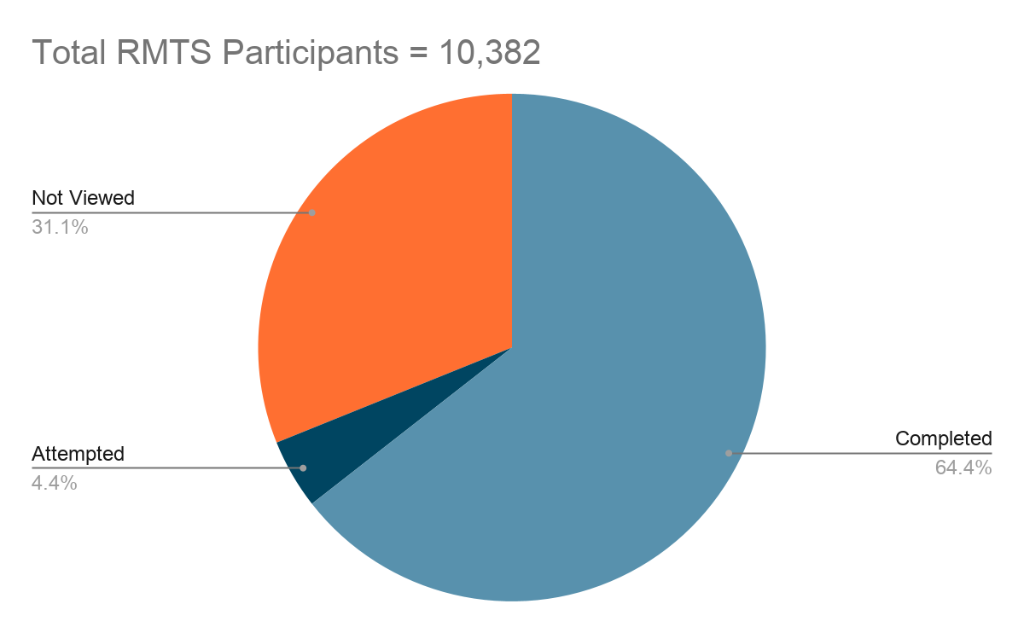
RMTS Participant Training Compliance as of 2/28/2026

Slide 6
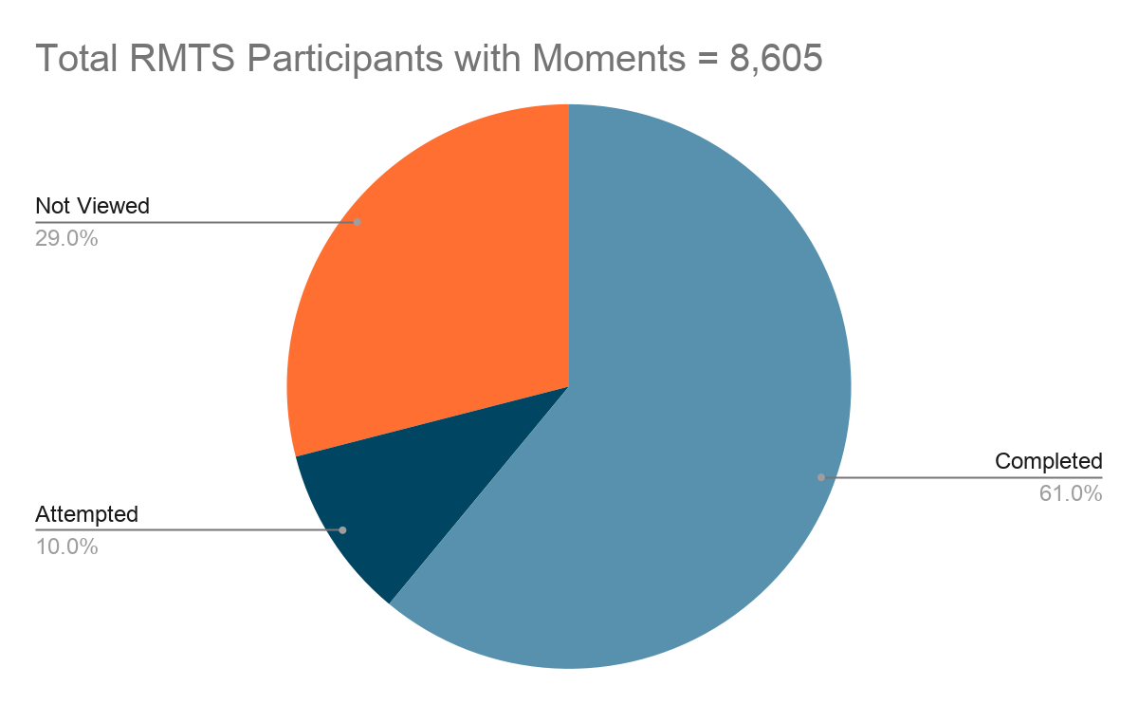
RMTS Participant Training Compliance as of 2/28/2026

Slide 7
Coordinator Role:
Monitoring Compliance
Establish targeted training completion dates at the beginning of the school year to support efficient monitoring of staff compliance
Monitor training completion status for all assigned staff
Follow up with staff who have not completed training by the established due date
Copy the staff member’s supervisor on follow-up communications when training remains incomplete after the due date
Notes:
Emphasize targeting August/September for completion for easier monitoring (even if the provider is still within the 1 year timeframe) - we want to make sure if there are new July participants they are covered and not wait until Aug/Sept

Slide 8
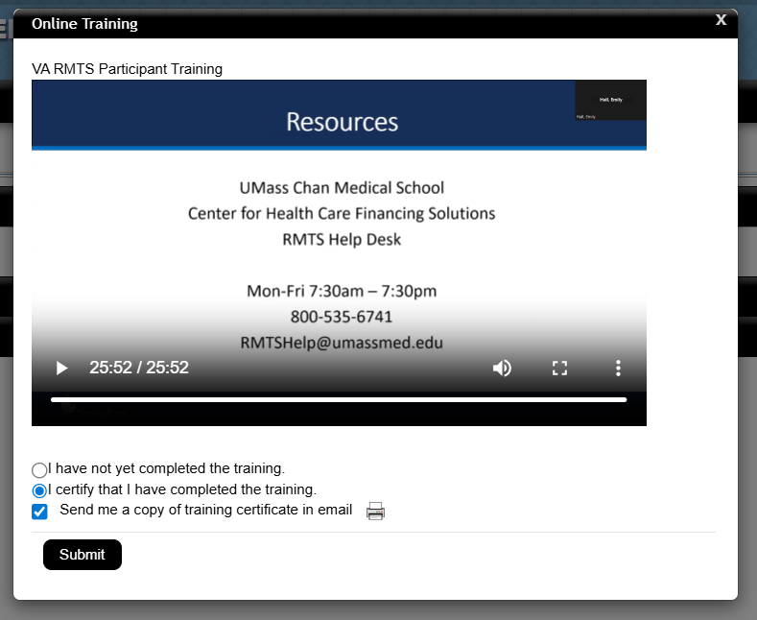
⚠️ Important:
You must select “I certify that I have completed the training”
AND click Submit for training to count as complete.
*Recommended to request providers forward email to Coordinator.

Slide 9
Options to Complete Training
01. Individually
Sample “Welcome” Emails
02. Group/Department Meetings *email to UMASS
03. Add to personal calendars *New Hires
04. Utilize school or division Professional Development *Points
Notes:
UMASS no longer sends “Welcome Back” email
Participate in or send details to supervisor to present during Dept. Meetings
Send personal calendar invites to New Hires (if they need more support)
Outline times to complete during Teacher Work/PD days

Slide 10
RMTS Training Summary Report Step-by-Step Directions
Start Here!
Online Training
Training Summary
Viewed Report
Excel Download
https://www.chcf.net/chcfweb/
Left Column, 4th Row
VA RMTS Participant Training
*Recommended
Details
Sign in with User ID and Password
Online Training Materials
Training Summary
Training Documents Viewed Reports
Training Documents Not Viewed Report
Select State, School Division, Active Users, Time Study Participants, All, Start/End Dates, VA RMTS Participant Training
School Division, Last/First Name, User ID, User Status, Employee ID, Job Type, Job Description, Email, Training Material Title, Date Accessed, Certification Date, Certification, No. of Attempts

Slide 11
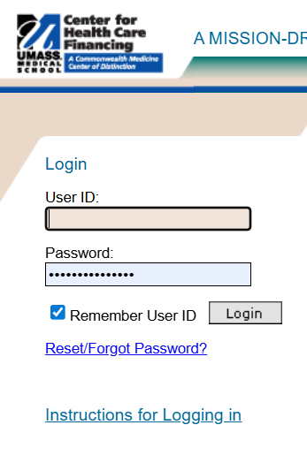
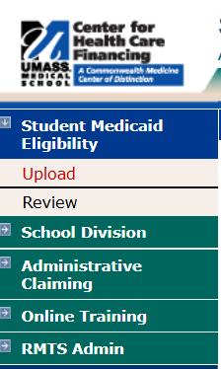
Start Here!
https://www.chcf.net/chcfweb/

Slide 12
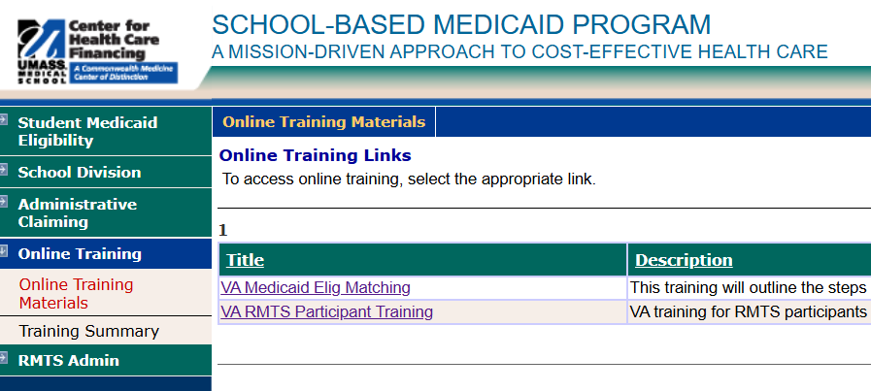
Online Training
Select “Online Training” → Left column, 4th row
Notes:
Emphasize targeting August/September for completion for easier monitoring (even if the provider is still within the 1 year timeframe)

Slide 13
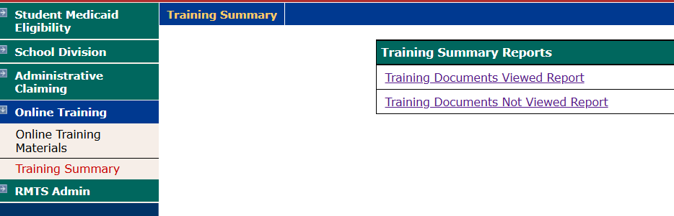
Training Summary
Training Documents Viewed Reports
Training Documents Not Viewed Report
Notes:
Explain the difference between the two options

Slide 14
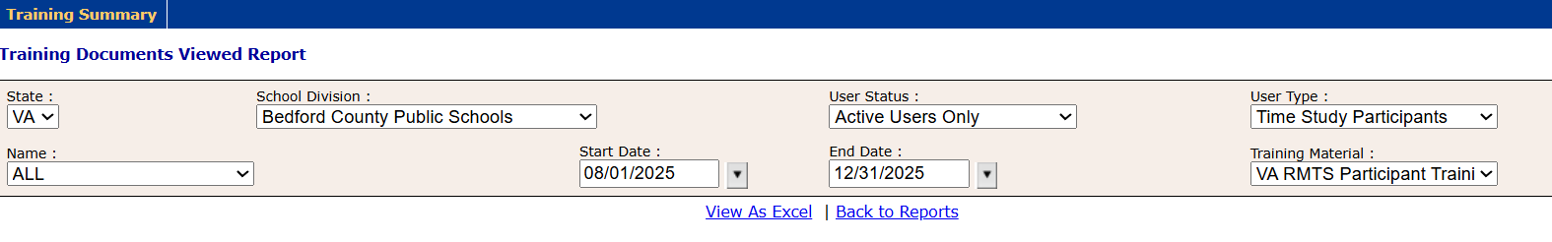
Viewed (Recommended)
Select: State, School Division, Active Users Only, Time Study Participants, All, Start/End Dates, VA RMTS Participant Training

Slide 15
Excel Download
Email
Training Material Title
Date Accessed
Certification Date
Certification
No. of Attempts
School Division
Last/First Name
User ID
User Status
Employee ID
Job Type
Job Description

Slide 16
Optional Templates
New Staff Tasks
Provider Checklist
VA RMTS Participant Training List
Medicaid Sites/Login Info
Notes:
Spend time showing these samples and explaining how we use them and how they can be modified (Should we provide any paper copies? How many participants usually attend meetings?

Slide 17
Any questions? Ask away!
Notes:
Medicaid Region 5 Coordinator Contact (25-26)

Slide 18
Contact Information
Emily Hall
Jill J. Robinson, Ed. S.
Carmen Johnson, M.Ed.
Program Director, School-Based Medicaid Health Care Finance Solutions For Health Consulting at
UMass Chan Medical School
Coordinator for Medicaid Program and Related Services
Virginia Beach City Public Schools
Coordinator of Medicaid & Support Services
Bedford County Public Schools
508-258-9351
Toll Free: 800-535-6741
540-586-1045 ext. 10231
757-263-2835
Emily.Hall@umassmed.edu
forhealthconsulting.umassmed.edu
carmen.johnson@bedford.k12.va.us
Jill.Robinson2@vbschools.com

