Slide 1
Medicaid and Schools Program
Administrative Activity Claims
August 2025
https://www.dmas.virginia.gov/for-providers/benefits-services-for-providers/school-based-services/

Slide 2
Learning Objectives
Understand what work activities School Division staff do that the Medicaid program considers to be reimbursable “Medicaid Administrative Activities.”
Understand how the reimbursement process works for AAC.
Know the timeframes and deadlines for claiming AAC.
Understand the allowable expenditures for reimbursement in the AAC program.
Gain some helpful tips and tools to ensure that your school division is maximizing your AAC reimbursement while meeting all program requirements.
https://www.dmas.virginia.gov/for-providers/benefits-services-for-providers/school-based-services/
Notes:
Cher

Slide 3

What is Administrative Claiming?
Hmmm… what exactly does that mean?
Medicaid Administrative Activities Claiming (AAC) is a joint state-federal program which offers reimbursement for the costs incurred by school divisions to help enroll eligible children (and families) in the Medicaid program, and to assist children who are already enrolled in Medicaid to access the benefits available to them.
https://www.dmas.virginia.gov/for-providers/benefits-services-for-providers/school-based-services/
Notes:
Cher

Slide 4

Are These Examples of Administrative Activities?
Are these activities reimbursed in AAC? | Yes | No
1. Completing the supporting paperwork around documenting and billing for the provision of direct health services, such as PT, OT, Speech Therapy, Nursing and mental/behavioral health services
2. Administrative support for the Special Education department, such as maintaining student IEP files, scheduling IEP meetings
3. Work medical practitioners (such as PTs and OTs) do related to IEP meetings and forms, such as writing IEPs or participating in IEP meetings
4. Obtaining parental consent to bill Medicaid
5. The direct provision of medical care to a student, i.e. providing a speech therapy session to a student
https://www.dmas.virginia.gov/for-providers/benefits-services-for-providers/school-based-services/
Notes:
Cher

Slide 5
What is Administrative Claiming? (2)
School-Based Administrative Claiming is a federal reimbursement program that recognizes the important role that public schools play in
identifying and enrolling children and families in the Medicaid program,
assisting families when applying for Medicaid,
supporting families to stay enrolled in Medicaid.
Additionally, schools are uniquely situated to assist children in accessing benefits and services available to them.
It is in the interest of both the Medicaid program and the school systems that children come to school healthy and ready to learn.
https://www.dmas.virginia.gov/for-providers/benefits-services-for-providers/school-based-services/
Notes:
Cher

Slide 6
What is Administrative Claiming? (3)
Administrative Claiming provides reimbursement for work that improves access to health care:
Medicaid outreach & application assistance
Specialized transportation scheduling/arranging
Translation services related to health care service delivery
Program planning and policy development related to the delivery of health services
Referral, coordination and monitoring of health services
Note: Work related to the provision of health care services (including time preparing to deliver services and time spent documenting services) is reimbursed through the annual Direct Service Cost Report
https://www.dmas.virginia.gov/for-providers/benefits-services-for-providers/school-based-services/
Notes:
Cher

Slide 7
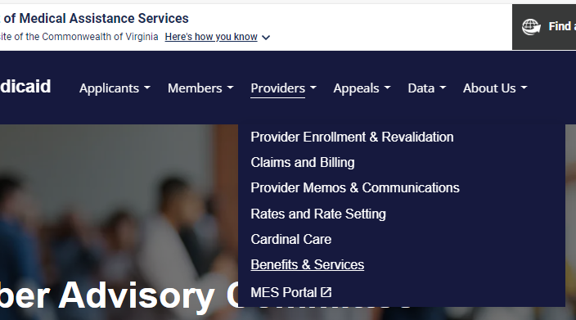
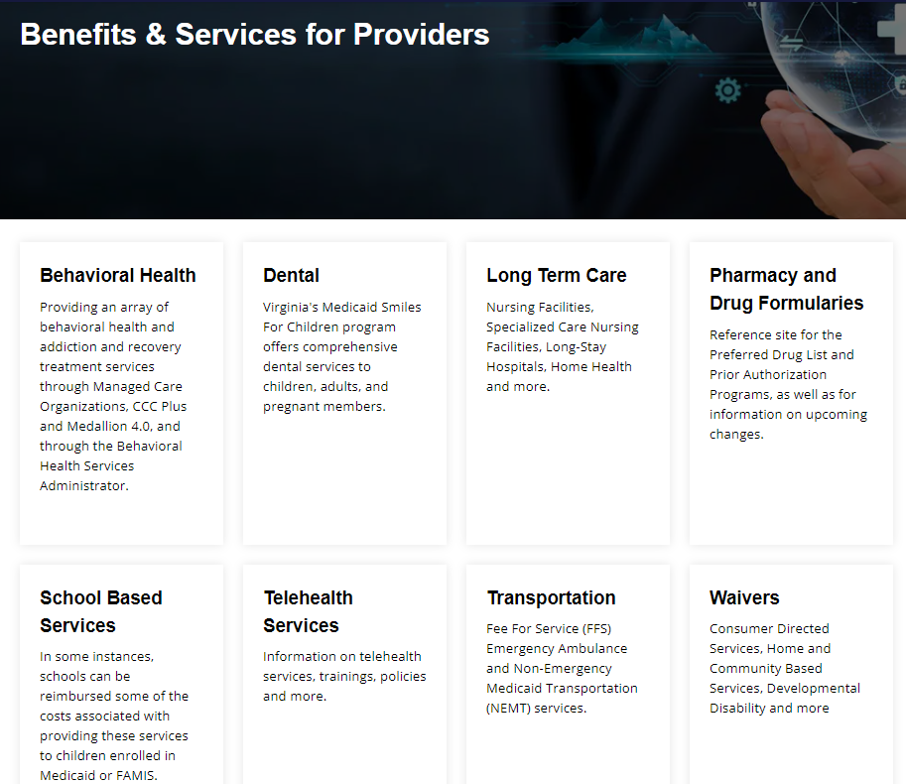
Additional Resources on Administrative Activities
Medicaid and Schools program information is easy to find on the DMAS website. You don’t have to remember the link, simply navigate to:
https://www.dmas.virginia.gov
Providers
  Benefits & Services
    School Based Services
User Guide for Administrative Claiming- Updated January 2024
RMTS Coordinator Training May 2025
https://www.dmas.virginia.gov/for-providers/benefits-services-for-providers/school-based-services/
Notes:
Cher

Slide 8
AAC Overview
Allowable Costs for Administrative Activities
RMTS Results
(Statewide)
Medicaid Penetration Factor
(School Division specific)
Gross Medicaid Reimbursable Amount
Cost-Based Reimbursement Methodology
$500,000 X 10% X 50% = $25,000
Allocation Factor:
What portion/percent of the cost is attributed to performing Medicaid-reimbursable work activities?
Allocation Factor:
What portion/percent of the cost is attributed to performing those activities on behalf of or with a Medicaid student?
https://www.dmas.virginia.gov/for-providers/benefits-services-for-providers/school-based-services/
Notes:
Emily

Slide 9
Claiming Timeline and Deadlines
Administrative Activity Claims (AAC) should be submitted quarterly:
Claims must be filed within seven (7) quarters
Only claims submitted by October 15th following the close of the fiscal year will be used to pre-populate information into the cost reports
Qtr | Claiming Period | Earliest Claim Deadline | Earliest Certification Deadline | Latest Claim Deadline | Latest Certification Deadline
1 | 7/1/25 - 9/30/25 | 1/15/26 | 1/22/26 | 7/15/27 | 7/22/27
2 | 10/1/25 - 12/31/25 | 4/15/26 | 4/22/26 | 10/15/27 | 10/22/27
3 | 1/1/26 - 3/31/26 | 7/15/26 | 7/22/26 | 1/15/28 | 1/22/28
4 | 4/1/26 - 6/30/26 | 10/15/26 | 10/22/26 | 4/15/28 | 4/22/28
https://www.dmas.virginia.gov/for-providers/benefits-services-for-providers/school-based-services/
Notes:
Emily

Slide 10
What data is needed to submit an AAC?
Allowable Costs for Administrative Activities
RMTS Results
(Statewide)
Medicaid Penetration Factor
(School Division specific)
Gross Medicaid Reimbursable Amount
Remember the Cost-Based Reimbursement Methodology
Allowable Costs:
Staffing Costs (salaries & benefits)
Materials & Supplies
Capital Costs
Indirect Costs
RMTS Results:
Percent of staff time allocated to AAC work activities
Medicaid Penetration Factor:
Percent of your division’s students who are enrolled in Medicaid/FAMIS
UMass Chan takes care of these for you!
https://www.dmas.virginia.gov/for-providers/benefits-services-for-providers/school-based-services/
Notes:
Cher

Slide 11
What data is needed to submit an AAC? (2)
Allowable costs related to performing Medicaid Administrative activities are:
Salary and employer-paid benefit costs for staff who performed the work
  Employer-paid benefit costs include:
    - Medicare - Health Insurance
    - Retirement - Dental Insurance
    - Social Security - Other benefits
Material and supply costs related to the performance of Medicaid administrative activities
  Costs for health supplies must be excluded
  Costs for educational supplies must be excluded
Capital Costs
https://www.dmas.virginia.gov/for-providers/benefits-services-for-providers/school-based-services/
Notes:
Cher

Slide 12
Where/How to gather cost data
In most school divisions, the Medicaid Coordinator files the claim. But most coordinators need support and assistance to do so.
Information Needed | Who will provide the information? | How much time do they need to prepare? | What’s the correct data source? | How will the information be verified?
Staff salary | Payroll? | 1 week? | Payroll system? | Payroll reports?
Employer paid benefits | HR? Payroll? | 10 days? | Payroll system? | Payroll reports?
Staff funding source & FTE | Business office? | 1 week? | General Ledger? | GL reports?
Material & supply costs | Accounts Payable? | 2 weeks? | Paid invoices? | GL reports?
Capital costs | Business office? | 2 weeks? | Financial reports? | Financial reports?
https://www.dmas.virginia.gov/for-providers/benefits-services-for-providers/school-based-services/
Notes:
Cher

Slide 13
Rules for Reporting Expenditures
For all expenditures that are allowable in the claim, these things are always true:
All costs are claimed in the period related to the service date of the costs (not cash-based accounting)
All expenditures that were funded by a Federal Grant (including IDEA & CARES funding) must be excluded
All expenditures that were a required match for a Federal Grant must be excluded
All costs used to calculate the Indirect Cost Rate must be excluded. (Those costs are reimbursed through the application of the ICR to the claim)
Only expenditures funded from State/Local funding sources can be claimed
https://www.dmas.virginia.gov/for-providers/benefits-services-for-providers/school-based-services/
Notes:
Cher

Slide 14
Reporting Costs in the Correct Period
All costs are claimed in the period relative to the service date of the costs (not cash-based accounting)
Also, the Medicaid Program is a reimbursement program, which means that expenditures must have already been incurred (paid) to be claimed.
Example:
Expense | Service Date/Period | Date Paid (“check date”) | Claim Quarter
Staff Salary | 9/13-9/24 (workdays) | 9/28 | Q1 (7/1-9/30)
Supplies | 9/20 (order received) | 1/26 | Q1 (7/1-9/30)
Health Insurance | October (coverage effective) | 9/15 | Q2 (10/1-12/31)
https://www.dmas.virginia.gov/for-providers/benefits-services-for-providers/school-based-services/
Notes:
Cher

Slide 15
Reporting Costs in the Correct Period (2)
Expense | Service Date/Period | Date Paid (“check date”) | Claim Quarter
Staff Salary | 9/13-9/24 (workdays) | 9/28 | Q1 (7/1-9/30)
Supplies | 9/20 (order received) | 1/26 | Q1 (7/1-9/30)
Health Insurance | October (coverage effective) | 9/15 | Q2 (10/1-12/31)
What happens if I file my Q1 claim on 1/15, before the supply invoice has been paid? Do I:
  Claim the supply cost in my Q2 claim
  Amend my Q1 claim (in the following quarter) to add the costs, after the invoice has been paid
  I don’t get to claim this cost, it cannot be reimbursed now
https://www.dmas.virginia.gov/for-providers/benefits-services-for-providers/school-based-services/
Notes:
Cher

Slide 16
What Staff are Included in the AAC?
Staff who are expected to perform Medicaid reimbursable work activities were identified by each school division prior to the start of the quarter and were included in the Random Moment Time Study (RMTS) participant list for the quarter.
The three Job Pools for the RMTS are:
Pool 1: Administrative Services Only
Pool 2: Nursing, Psychological & Medical Services
Pool 3: Therapy Services
All three Job Pools are included in Administrative Claiming
Note: Only Pools 2 and 3 are included for Direct Services reimbursement through the annual Cost Report
https://www.dmas.virginia.gov/for-providers/benefits-services-for-providers/school-based-services/
Notes:
Cher

Slide 17
Additional Resource on AAC Cost Reporting
Medicaid and Schools program information is easy to find on the DMAS website. You don’t have to remember the link, simply navigate to:
https://www.dmas.virginia.gov
Providers
  Benefits & Services
    School Based Services
User Guide for Administrative Claiming- Updated January 2024
https://www.dmas.virginia.gov/for-providers/benefits-services-for-providers/school-based-services/
Notes:
Cher

Slide 18
Claiming Staff Salary & Benefits costs
Live Demonstration:
Follow along with the instruction guide to:
Export a list of staff who participated in RMTS and are available for claiming
Re-organize the staff data so that it’s ready to copy into the salary & benefit upload template
Complete the upload template
Upload salary & benefit costs into the claim
Option to use online data entry screens
https://www.dmas.virginia.gov/for-providers/benefits-services-for-providers/school-based-services/
Notes:
Emily

Slide 19
Reminder about Funding Sources
AAC Salary and Benefit funding sources must be identified
Percentage of State/Local funding
Percentage of IDEA funding
Percentage of Federal funding
Percentage of Other funding
The total of the 4 components above must equal 100%
If the ‘other’ percentage is greater than zero then a narrative description is required
https://www.dmas.virginia.gov/for-providers/benefits-services-for-providers/school-based-services/
Notes:
Emily

Slide 20
Capital Costs
The Administrative Activity Claims allow for an allocation of Capital Costs to be added to the other reported expenditures in the reimbursement calculation.
Report capital costs with Quarter 1 AAC – same data will automatically carry forward into remaining 3 quarterly claims
Capital costs include:
Acquisition Costs of Fixed Assets
Acquisition Costs of Major Moveable Assets
Net Interest Expense associated with financing/loans for school building acquisition, construction, remodeling and equipment
To allocate the costs, also report the actual division-wide (all personnel and district payroll) salaries and fringe benefits (employer portion only) for the prior fiscal year, excluding any federally funded portions.
https://www.dmas.virginia.gov/for-providers/benefits-services-for-providers/school-based-services/
Notes:
Cher

Slide 21
Capital Costs (2)
Key cost principles and regulations to keep in mind:
All costs claimed must comply with the “Super Circular” - OMB Uniform Administrative Requirements, Cost Principle, and Audit Requirements for Federal Awards (2 C.F.R. §200)
Reported costs “must be supported by adequate property records, and physical inventories must be taken at least once every two years to ensure that the assets exist and are usable, used, and needed” (2 C.F.R. §200.436).
Per 2 C.F.R. § 200.12 and § 200.33, capital assets reported in this section “means tangible assets currently in use in operations having a useful life of more than one year which are capitalized in accordance with Generally Accepted Accounting Principles (GAAP)” (§ 200.12) and have a per-unit acquisition cost of $5,000 or more (§ 200.33).
https://www.dmas.virginia.gov/for-providers/benefits-services-for-providers/school-based-services/
Notes:
Cher

Slide 22
Capital Costs (3)
Acquisition Costs of Fixed and Major Moveable Assets:
Report the accumulated acquisition cost of building and fixed assets
Do not report an insurance valuation or replacement cost
Do not depreciate the cost
Exclude the cost of fully depreciated assets (more than 50 years old for fixed assets; more than 15 years old for major moveable assets)
Exclude the cost of land
Exclude portion of the cost of buildings and equipment paid or donated by the Federal Government
Exclude rent or lease payments
https://www.dmas.virginia.gov/for-providers/benefits-services-for-providers/school-based-services/
Notes:
Cher

Slide 23
Capital Costs – Net Interest Expense
Net Interest Expense associated with financing/loans for school building acquisition, construction, remodeling and equipment:
Report the net interest expense associated with school building acquisition, construction, remodeling and equipment for the prior fiscal year, where the financing is provided by a bona fide third party external to the municipality or school division.
Report the accrued interest paid minus accrued interest earned as the accrued net interest expense.
https://www.dmas.virginia.gov/for-providers/benefits-services-for-providers/school-based-services/
Notes:
Cher

Slide 24
Capital Costs – Demonstration
Live Demonstration:
Complete the “annual data” section of a Q1 AAC
See that the annual data is pre-populated into Q2-4
https://www.dmas.virginia.gov/for-providers/benefits-services-for-providers/school-based-services/
Notes:
Emily

Slide 25
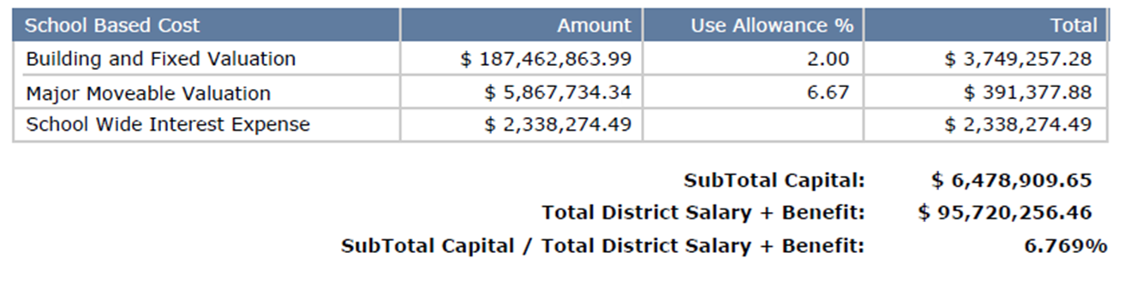
Annual Costs: Calculate Capital % Rate
Capital Percentage Rate: The percentage (allocation factor) of capital costs attributable to what is used by the staff included in the claim.
https://www.dmas.virginia.gov/for-providers/benefits-services-for-providers/school-based-services/
Notes:
Emily

Slide 26
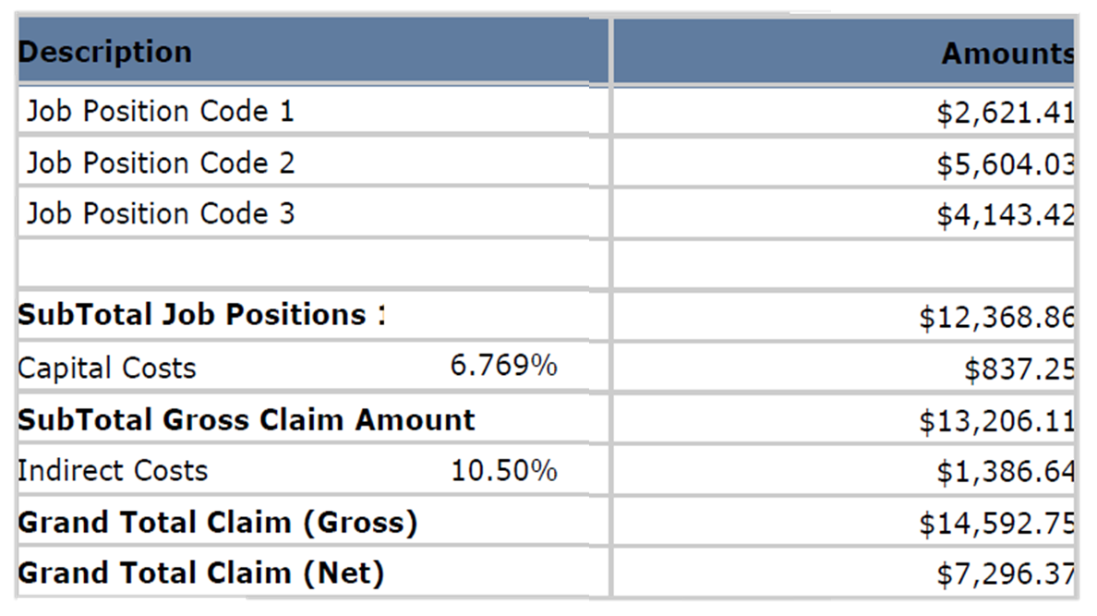
Annual Cost Calculation: Apply Capital % Rate
Claim Summary Report:
https://www.dmas.virginia.gov/for-providers/benefits-services-for-providers/school-based-services/
Notes:
Emily

Slide 27
Materials & Supplies Calculation
Material and supply costs related to the performance of Medicaid administrative activities may be claimed.
Costs for health supplies must be excluded
Costs for educational supplies must be excluded
Think about what materials and supplies were used by school division staff in performance of reimbursable Medicaid Administrative Activities, such as:
  Medicaid outreach: brochures, forms, flyers
  Specialized transportation scheduling: forms, office supplies
  Program planning and policy development related to the delivery of health services: supplies for a meeting, forms, office supplies
  Referral, coordination and monitoring of health services: forms, office supplies
https://www.dmas.virginia.gov/for-providers/benefits-services-for-providers/school-based-services/
Notes:
Cher

Slide 28

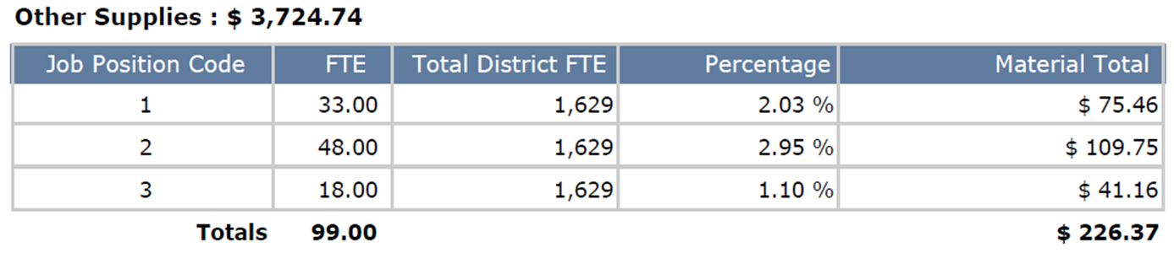
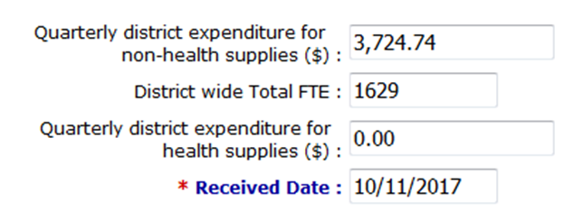
Materials & Supplies Calculation (2)
Materials & Supplies for AAC claims are calculated using the number of FTEs in your claim over your district-wide number of FTEs for a percentage that is applied to each pool for the amount of materials and supplies you provided.
3,724.74
https://www.dmas.virginia.gov/for-providers/benefits-services-for-providers/school-based-services/
Notes:
Cher

Slide 29
Medicaid Eligibility Data
Medicaid Eligibility Percentage:
Report two student counts based on the results of your Medicaid Eligibility Match completed as of the 1st day of the 3rd month of the quarter (Sept. 1, Dec. 1, March 1, June 1)
  Total number of students enrolled division wide as of the prescribed “snapshot” date
  Total number of those students (from #1) who were matched and determined to have active Medicaid or Medicaid Expansion coverage (do not count FAMIS students)
Include Medicaid & Medicaid Expansion students
Do NOT include FAMIS students
Calculated quarterly as of 9/1, 12/1, 3/1 and 6/1
https://www.dmas.virginia.gov/for-providers/benefits-services-for-providers/school-based-services/
Notes:
Cher

Slide 30
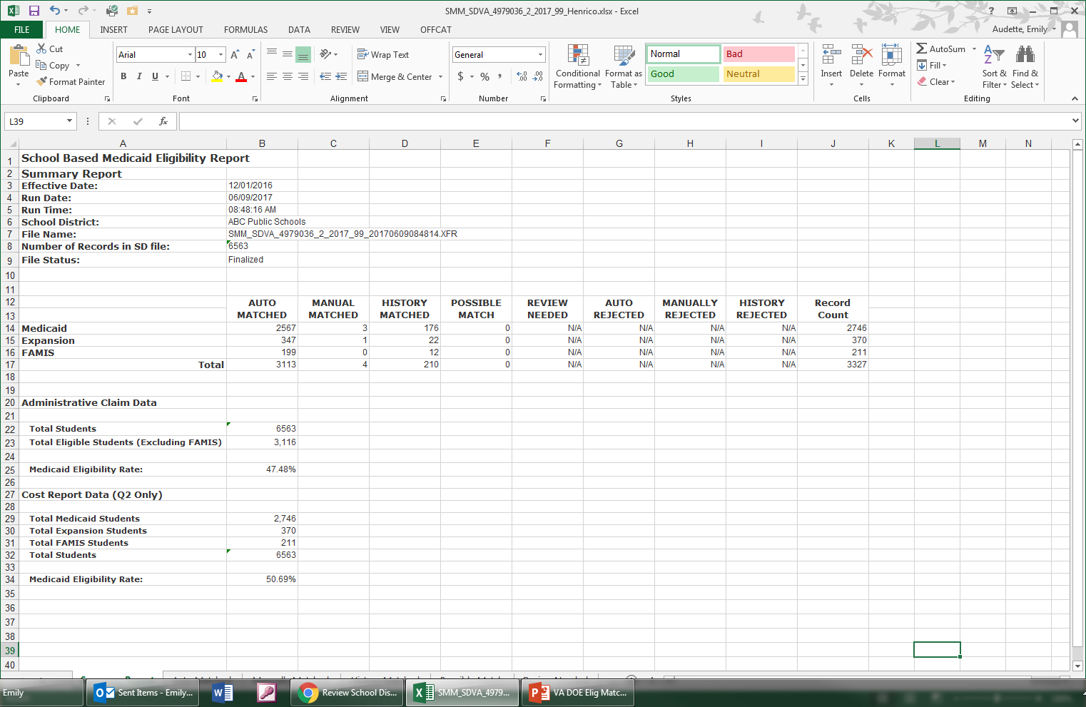
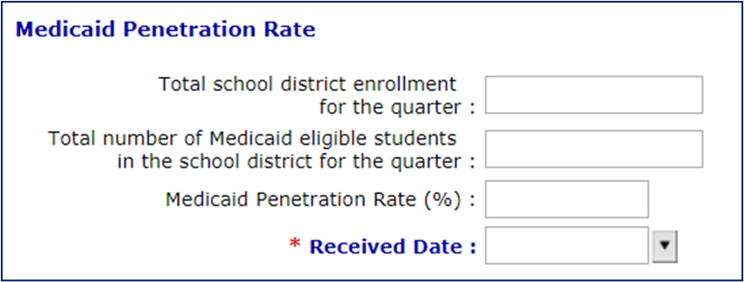
Medicaid Eligibility Data (2)
6563
3116
04/01/2023
https://www.dmas.virginia.gov/for-providers/benefits-services-for-providers/school-based-services/
Notes:
Cher

Slide 31
Additional Resources on Medicaid Eligibility Matching
Medicaid and Schools program information is easy to find on the DMAS website. You don’t have to remember the link, simply navigate to:
https://www.dmas.virginia.gov
Providers
  Benefits & Services
    School Based Services
Eligibility Matching Training
Medicaid Eligibility Matching User Guide
https://www.dmas.virginia.gov/for-providers/benefits-services-for-providers/school-based-services/
Notes:
Cher

Slide 32
Certification of Public Expenditure
UMass Chan will email the certification letter to you after completing a review of your claim.
Certification letters should be printed on School Division letterhead, signed by an officer of the school division, such as a Superintendent or appropriate designee, and sent to UMass Chan by the appropriate quarterly deadline (22nd of the submission month) so that your claim can be processed with the quarterly submission.
Any certification letters received after the deadline will be held and processed in the following quarterly submission.
https://www.dmas.virginia.gov/for-providers/benefits-services-for-providers/school-based-services/
Notes:
Cher

Slide 33
Best Practices
A few tips and best practices to keep in mind:
Get on a regular quarterly schedule for your claiming; set calendar reminders for due dates to stay on track.
Identify key people in your school division who will be responsible for the different pieces of information needed for AAC.
Maintain a claim back-up file where all supporting documentation for your claim is saved for audit purposes.
Monitor funding changes and grants.
Salary & benefits – only portion of salary related to the job that qualified for Medicaid.
When preparing your RMTS participant list, provide actual Employee ID numbers for staff for easy matching of that information to payroll data for gathering salary and benefits for the claim.
When all else fails – read the instructions! Then call UMass Chan for help.
https://www.dmas.virginia.gov/for-providers/benefits-services-for-providers/school-based-services/
Notes:
Cher

Slide 34

Questions?
UMass Chan Support Team:
800-535-6741
RMTSHelp@umassmed.edu
https://www.dmas.virginia.gov/for-providers/benefits-services-for-providers/school-based-services/

